Slide 1

FIFA World Cup Data 1930 – 2014
Data Analysis
BU6143: Business Intelligence
Final Presentation
By: Daniel Mühlbauer

Slide 2

Agenda
Dataset Overview
Dataset Cleaning and Preparation
Data Analysis
Suggested Actions
Question for Further Research
Source

Slide 3
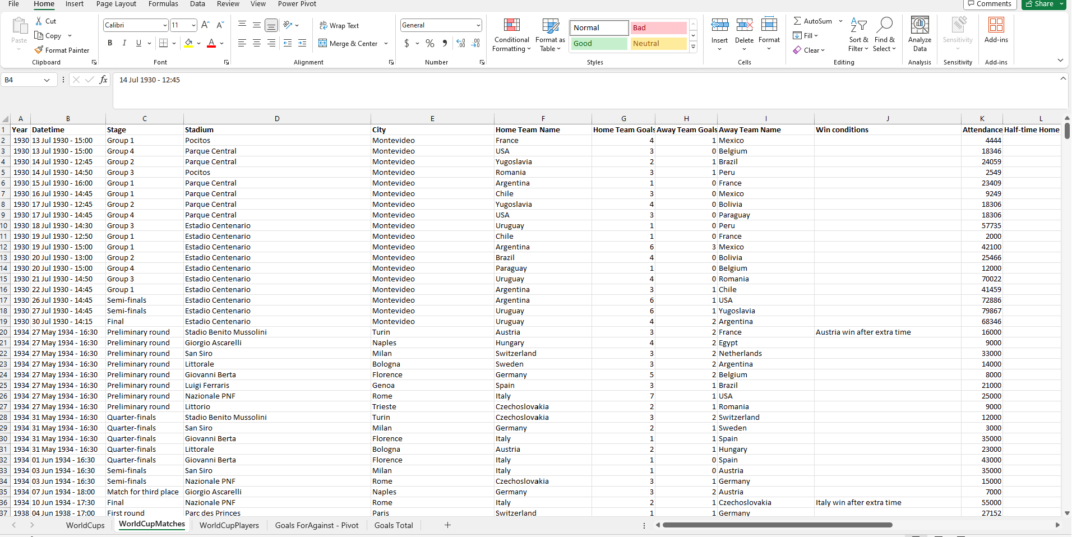
Dataset Overview
Notes:
Player Info wasn’t detailed so that focus is on World Cup Trends and Team Performance

Slide 4
Dataset Cleaning and Preparation
Excel:
Name Formatting
Combining Germany FR with Germany
Rename all: Côte d'Ivoire
Remove all: rn”>
Number Formatting
Converting Attendance Numbers
Pivot Tables to create Goal Differential Overview
Tableau:
Joining Datasets: Formatting Dates, Names
Country Grouping per Continent

Slide 5
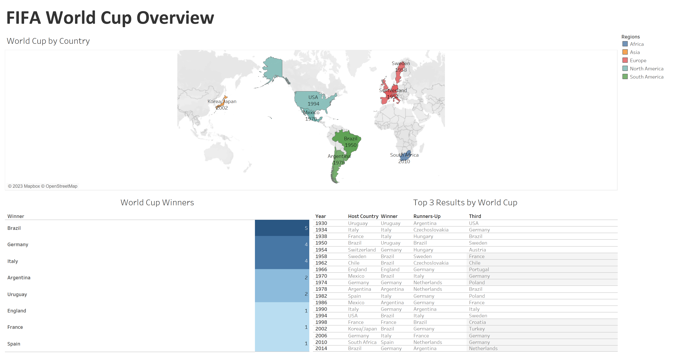

Slide 6
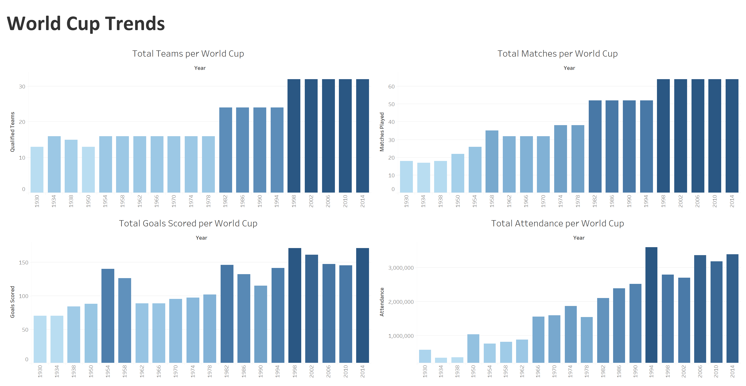

Slide 7
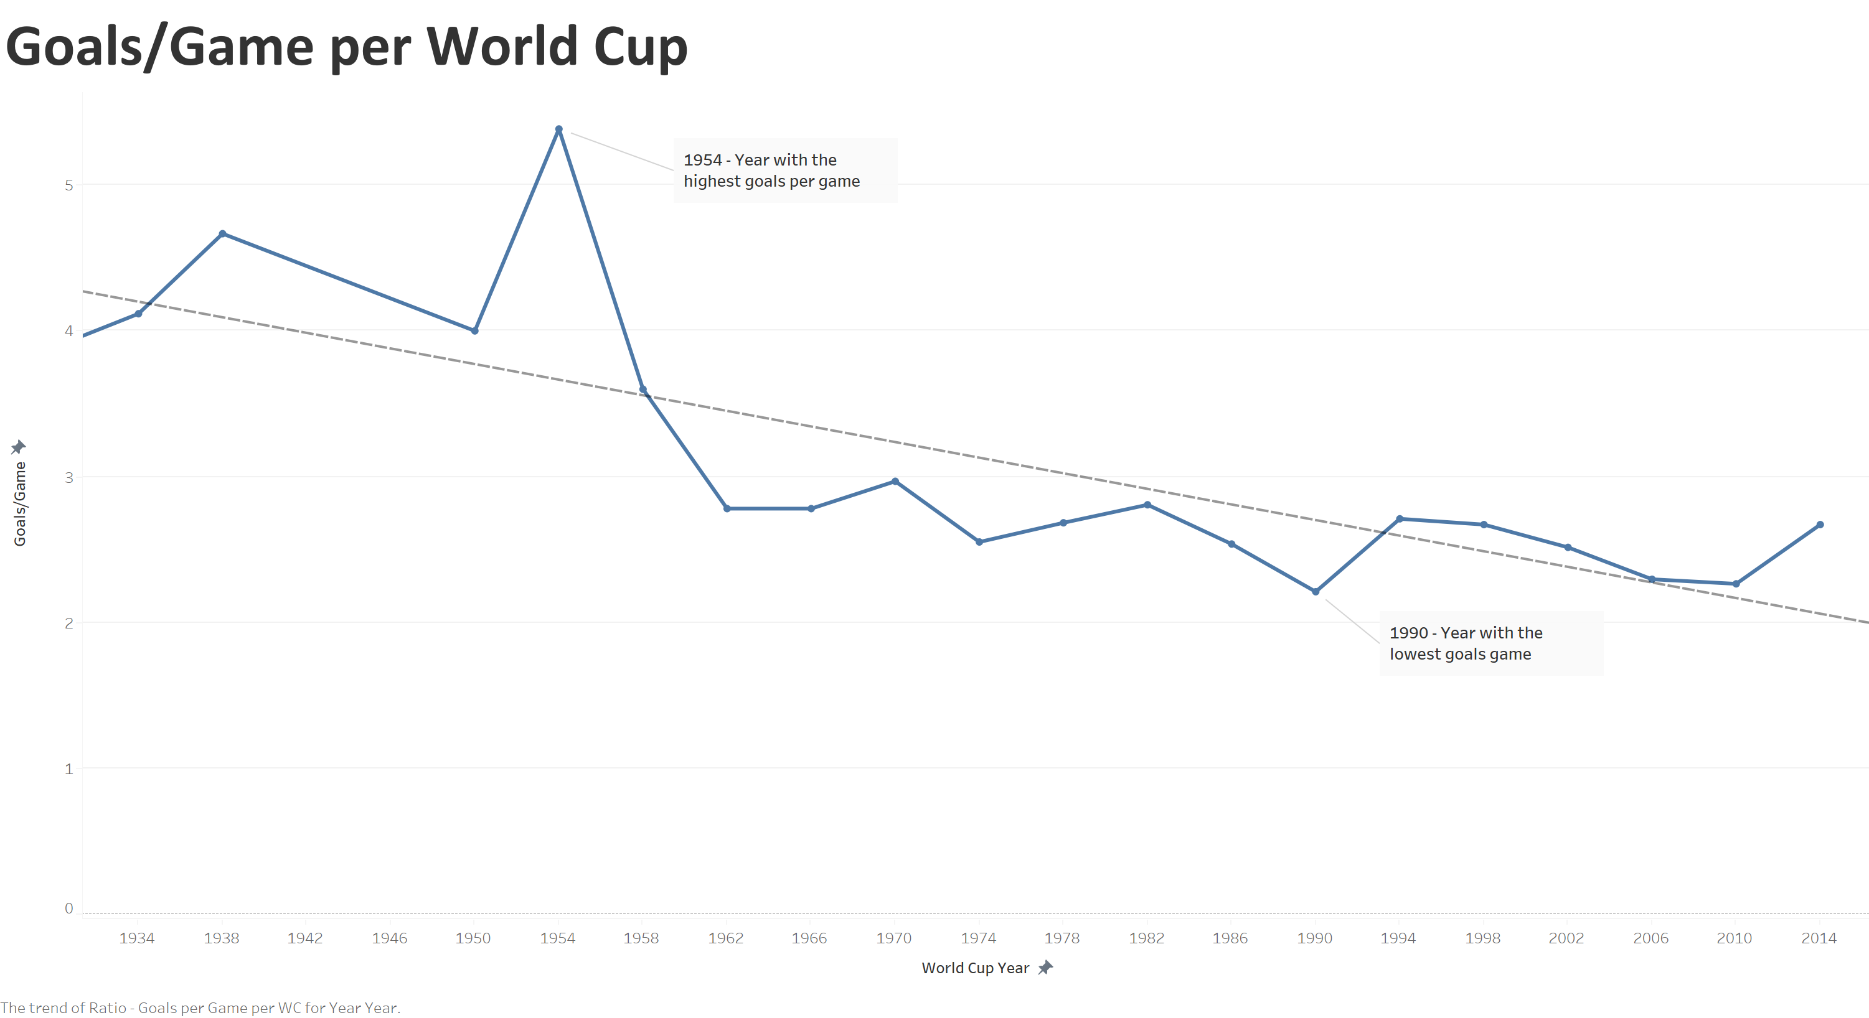

Slide 8
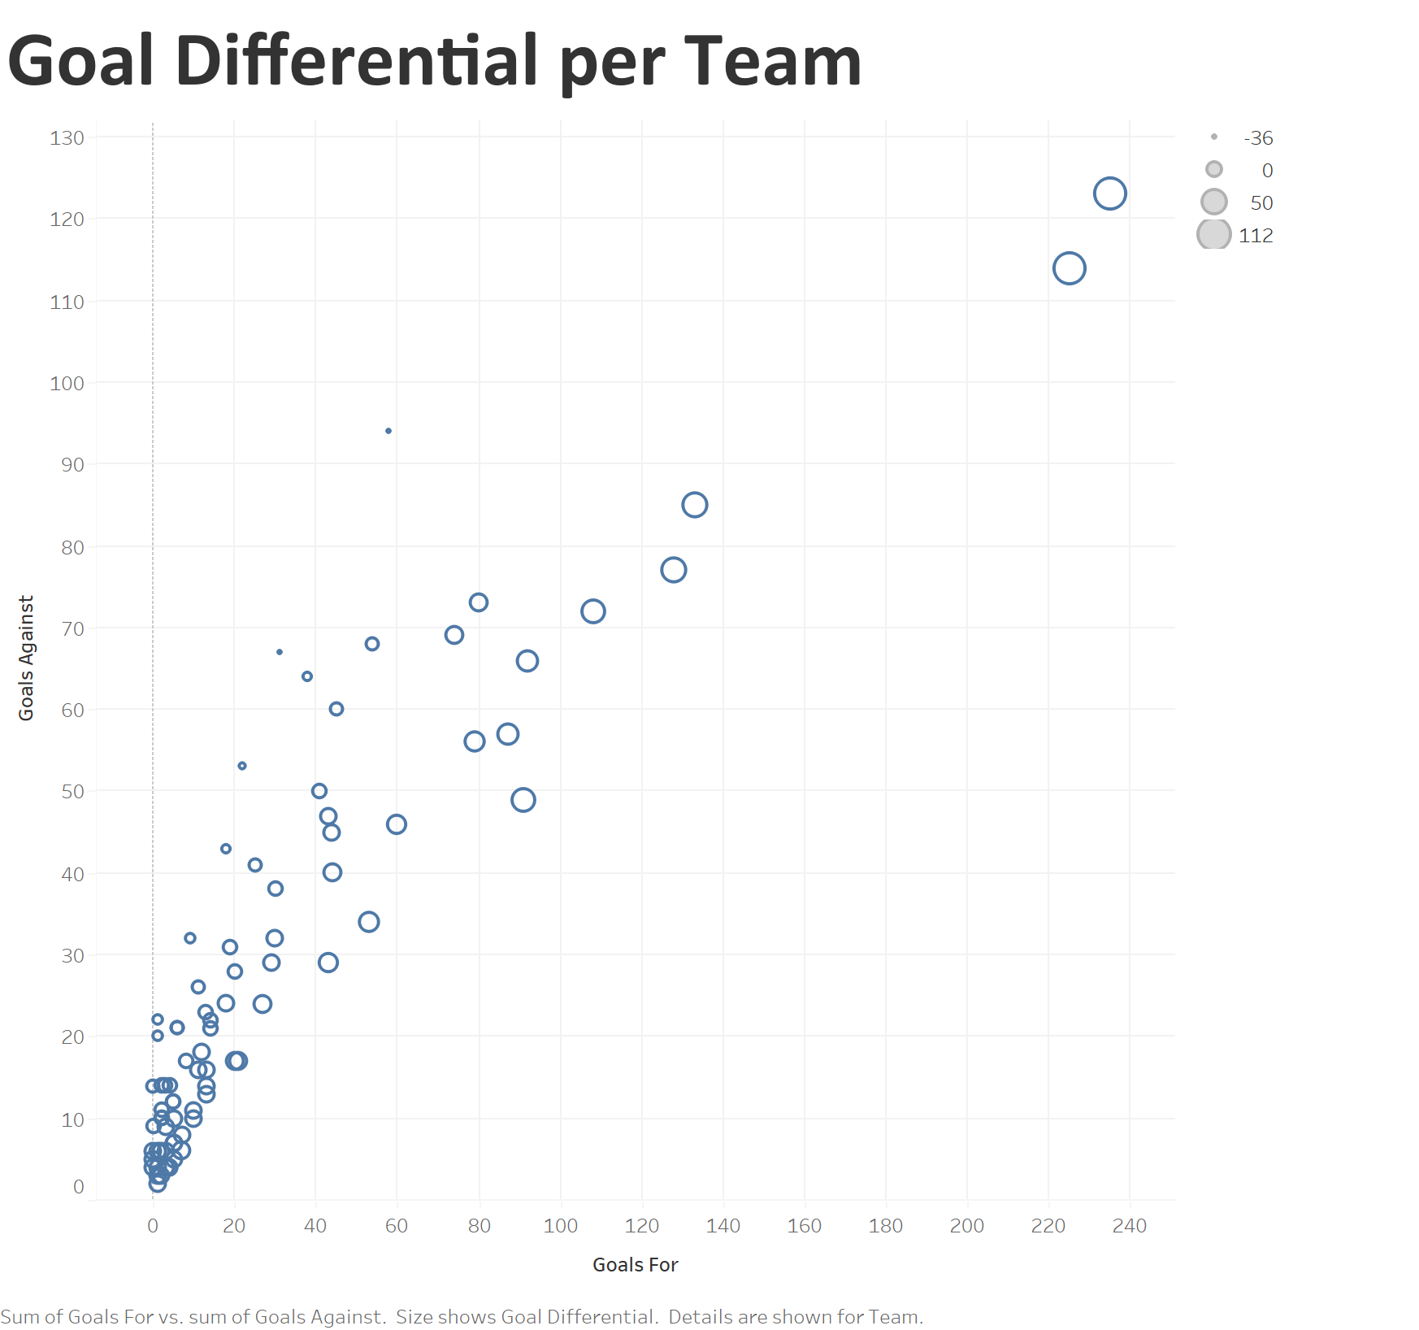

Slide 9
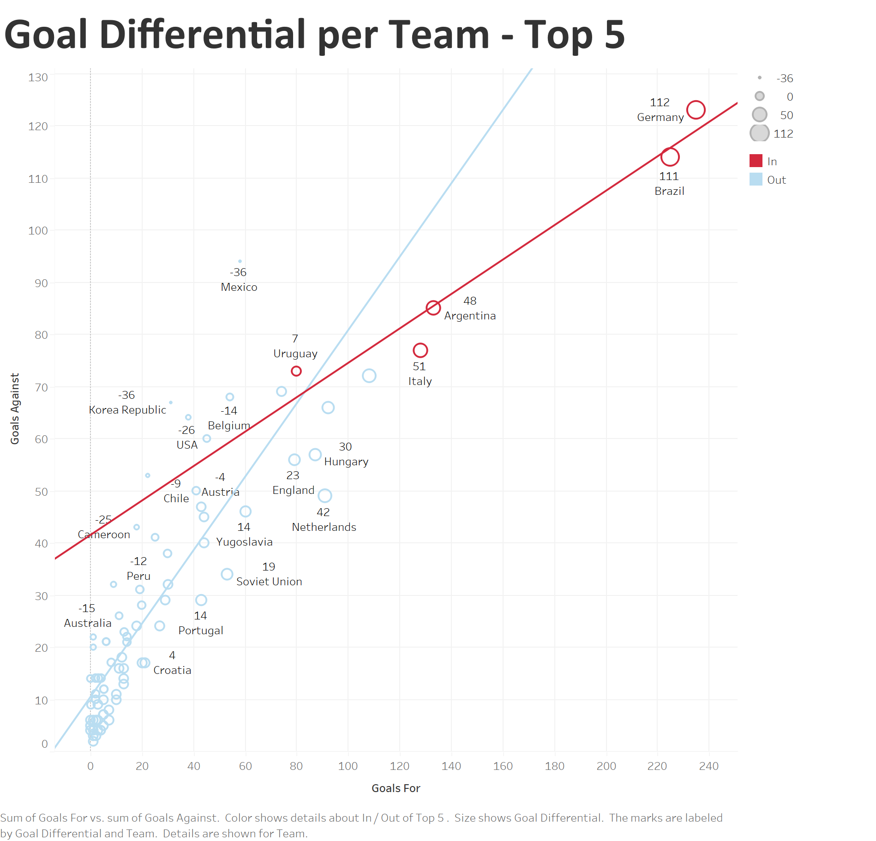

Slide 10
Suggested Actions
Team Performance:
Positive Goal Differential
Identify the Strategy for Team Success
World Cup:
Use Growth to enter new Places in World
Notes:
Positive Goal Differential: Consistent performance over the years
Identify Strategy for your Team Success: Comparing Top 5 -> Brazil / Germany focus on goalscoring whereas Italy focusing on defending
Use Growth to enter new places in World: Attendance increases, yet mainly competing in Europe and Americas -> use growth to enter into new places in world and bring positive/sustainable change as outlined in their slogan “For the Game. For the World.”

Slide 11
Question for Further Research
What detailed factors contribute to the success of teams in the World Cup?
Team Success Factors
Individual Success Factors
Locational Success Factors
Notes:
Team Success Factors: Strategy, style of play, tactics -> go into detail
Individual Success Factors: Age of players, specific attributes,
Locational Success Factors: altitude, geography, time of year

Slide 12
Source
https://www.kaggle.com/datasets/abecklas/fifa-world-cup/data
Notes:
Team Success Factors: Strategy, style of play, tactics -> go into detail
Individual Success Factors: Age of players, specific attributes,
Locational Success Factors: altitude, geography, time of year

